Slide 1
Foundations of Cryptography MAC, EUF-CMA, fixed-length MAC from PRF
LiangFeng Zhang
zhanglf@shanghaitech.edu.cn
SIST, ShanghaiTech, 2019F

Slide 2



Message Integrity
Transfer $1000 from Alice’s account to Bob’s
$$Alice$$
Questions that will be asked by the bank:
Is the message really from Alice?
Has the message been modified?
Message Integrity: prevent undetected tampering of messages
Unauthorized modifications should be detectable
Encryptions cannot provide message integrity:
Encryption can prevent unauthorized access of the messages
Encryption cannot prevent undetected tampering of messages

Slide 3

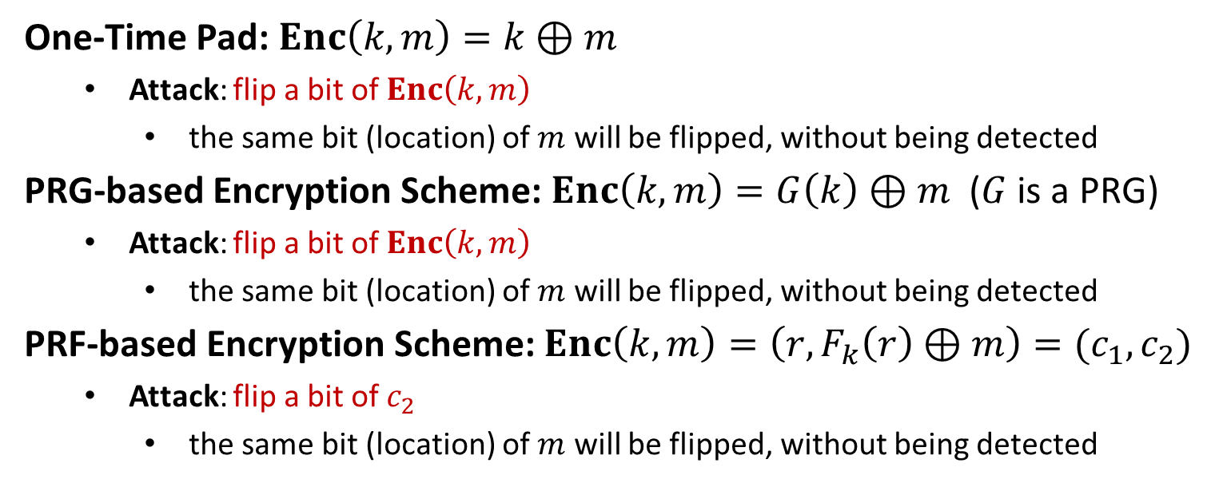
Encryption $⇏$ Integrity
One-Time Pad: $Enc\left(k,m\right)=k⊕m$
Attack: flip a bit of $Enc\left(k,m\right)$
the same bit (location) of $m$ will be flipped, without being detected
PRG-based Encryption Scheme: $Enc\left(k,m\right)=G\left(k\right)⊕m$ ($G$ is a PRG)
Attack: flip a bit of $Enc\left(k,m\right)$
the same bit (location) of $m$ will be flipped, without being detected
PRF-based Encryption Scheme: $Enc\left(k,m\right)=\left(r,F_{k}\left(r\right)⊕m\right)=(c_{1},c_{2})$
Attack: flip a bit of $c_{2}$
the same bit (location) of $m$ will be flipped, without being detected

Slide 4
Encryption $⇏$ Integrity
OFB: $F$ is a length-preserving PRF/PRP/sPRP
$$IV$$
$$F_{k}$$
$$F_{k}$$
$$F_{k}$$
$$m_{1}$$
$$⨁$$
$$m_{2}$$
$$⨁$$
$$m_{3}$$
$$⨁$$
$$IV$$
$$c_{1}$$
$$c_{2}$$
$$c_{3}$$
Attack: flip a bit of any of ciphertext blocks $c_{1},c_{2},c_{3}$
the same bit (location) of the message will be flipped, without being detected

Slide 5
Encryption $⇏$ Integrity
CTR: $F$ is a length-preserving PRF/PRP/sPRP
$$ctr$$
$$ctr+1$$
$$ctr+2$$
$$ctr+3$$
$$F_{k}$$
$$F_{k}$$
$$F_{k}$$
$$m_{1}$$
$$⨁$$
$$m_{2}$$
$$⨁$$
$$m_{3}$$
$$⨁$$
$$ctr$$
$$c_{1}$$
$$c_{2}$$
$$c_{3}$$
Attack: flip a bit of any of ciphertext blocks $c_{1},c_{2},c_{3}$
the same bit (location) of the message will be flipped, without being detected

Slide 6
Encryption $⇏$ Integrity
CBC: $F$ is a length-preserving PRP/sPRP
$$m_{1}$$
$$m_{2}$$
$$m_{3}$$
$$IV$$
$$⨁$$
$$⨁$$
$$⨁$$
$$F_{k}$$
$$F_{k}$$
$$F_{k}$$
$$IV$$
$$c_{1}$$
$$c_{2}$$
$$c_{3}$$
Attack: flip a bit of the initial vector $IV$
The same bit (location) of $m_{1}$ will be flipped, without being detected

Slide 7
Encryption $⇏$ Integrity
ECB: $F$ is a length-preserving PRP/sPRP
$$m_{1}$$
$$m_{2}$$
$$m_{3}$$
$$F_{k}$$
$$F_{k}$$
$$F_{k}$$
$$c_{1}$$
$$c_{2}$$
$$c_{3}$$
Attacks: Change the order of ciphertext blocks: $c_{1}c_{2}c_{3}→c_{3}c_{2}c_{1}$
decryption: $c_{3}c_{2}c_{1}→m_{3}m_{2}m_{1}$
The message blocks will be reordered, without being detected

Slide 9

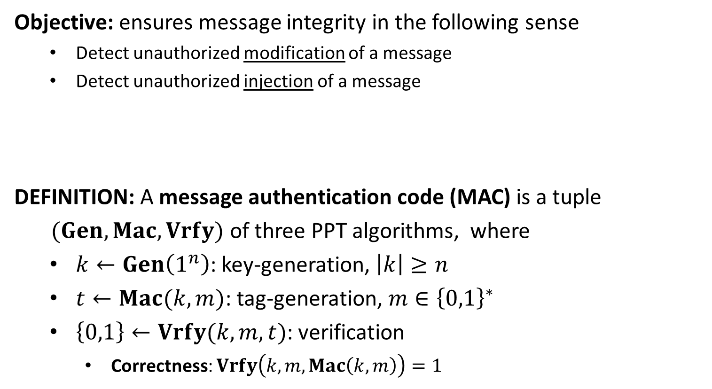




Message Authentication Code
Objective: ensures message integrity in the following sense
Detect unauthorized modification of a message
Detect unauthorized injection of a message
DEFINITION: A message authentication code (MAC) is a tuple
$(Gen, Mac,Vrfy)$ of three PPT algorithms, where
$k←Gen\left(1^{n}\right)$: key-generation, $\left|k\right|≥n$
$t←Mac(k,m)$: tag-generation, $m∈{\left\{0,1\right\}}^{∗}$
$\left\{0,1\right\}←Vrfy(k,m,t)$: verification
Correctness: $Vrfy\left(k,m,Mac\left(k,m\right)\right)=1$
message $m$
tag $t$
$$k$$
$$k$$

Slide 10
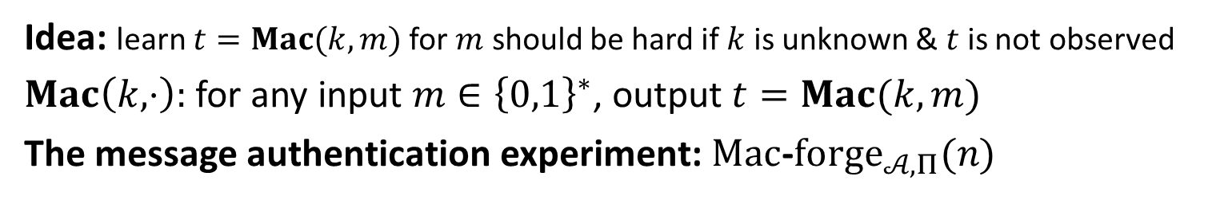
Security
Idea: learn $t=Mac(k,m)$ for $m$ should be hard if $k$ is unknown & $t$ is not observed
$Mac\left(k,⋅\right):$ for any input $m∈{\left\{0,1\right\}}^{∗}$, output $t=Mac(k,m)$
The message authentication experiment: $Mac$-$forge_{𝒜,Π}(n)$
$$k←Gen\left(1^{n}\right)$$
$$oracle access to$$
$$Mac(k,⋅)$$
$$Challenger$$
$$Adversary 𝒜$$
$$(m,t)$$
$$Mac\text{−}forge_{𝒜,Π}\left(n\right)=1 iff$$
$Vrfy\left(k,m,t\right)=1$
$m∉Q$
$Q:$ the set of messages queried by $𝒜$

Slide 11
Security
DEFINITION: $Π$is existentially unforgeable under an adaptive chosen-
message attack (EUF-CMA) if for all PPT adversary $𝒜$ there is a
negligible function $negl(⋅)$ such that
$\operatorname{Pr}\left[Mac\text{−}forge_{𝒜,Π}\left(n\right)=1\right] ≤negl(n)$,
where the probability is taken over the random coins of $𝒜$ and the
random coins used in the experiment.
Replay attack: an adversary may intercept $(m,t)$ and send it again
sequence numbers: need to be synchronized
time-stamp: send $T||m$ instead of $m$

Slide 13
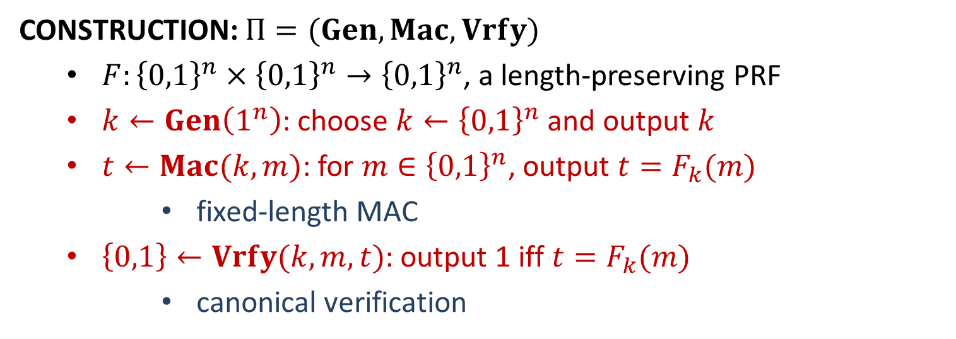
Fixed-Length MAC from PRF
CONSTRUCTION: $Π=(Gen, Mac,Vrfy)$
$F:{\left\{0,1\right\}}^{n}×{\left\{0,1\right\}}^{n}→{\left\{0,1\right\}}^{n}$, a length-preserving PRF
$k←Gen\left(1^{n}\right)$: choose $k←{\left\{0,1\right\}}^{n}$ and output $k$
$t←Mac(k,m)$: for $m∈{\left\{0,1\right\}}^{n}$, output $t=F_{k}(m)$
fixed-length MAC
$\left\{0,1\right\}←Vrfy(k,m,t)$: output 1 iff $t=F_{k}(m)$
canonical verification

Slide 14
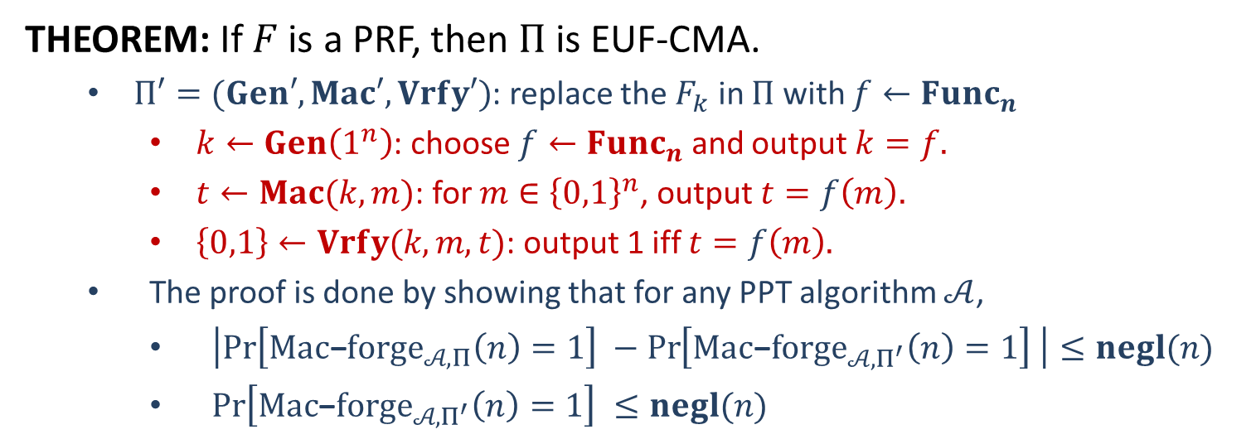
Security
THEOREM: If $F$ is a PRF, then $Π$ is EUF-CMA.
$Π′=(Gen′, Mac′,Vrfy′)$: replace the $F_{k}$ in $Π$ with $f←Func_{n}$
$k←Gen\left(1^{n}\right)$: choose $f←Func_{n}$ and output $k=f.$
$t←Mac(k,m)$: for $m∈{\left\{0,1\right\}}^{n}$, output $t=f\left(m\right).$
$\left\{0,1\right\}←Vrfy(k,m,t)$: output 1 iff $t=f\left(m\right).$
The proof is done by showing that for any PPT algorithm $𝒜$,
$\left|\operatorname{Pr}\left[Mac\text{−}forge_{𝒜,Π}\left(n\right)=1\right] −\operatorname{Pr}\left[Mac\text{−}forge_{𝒜,Π^{′}}\left(n\right)=1\right] \right|≤negl(n)$
$\operatorname{Pr}\left[Mac\text{−}forge_{𝒜,Π^{′}}\left(n\right)=1\right] ≤negl(n)$

Slide 15






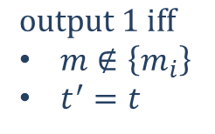

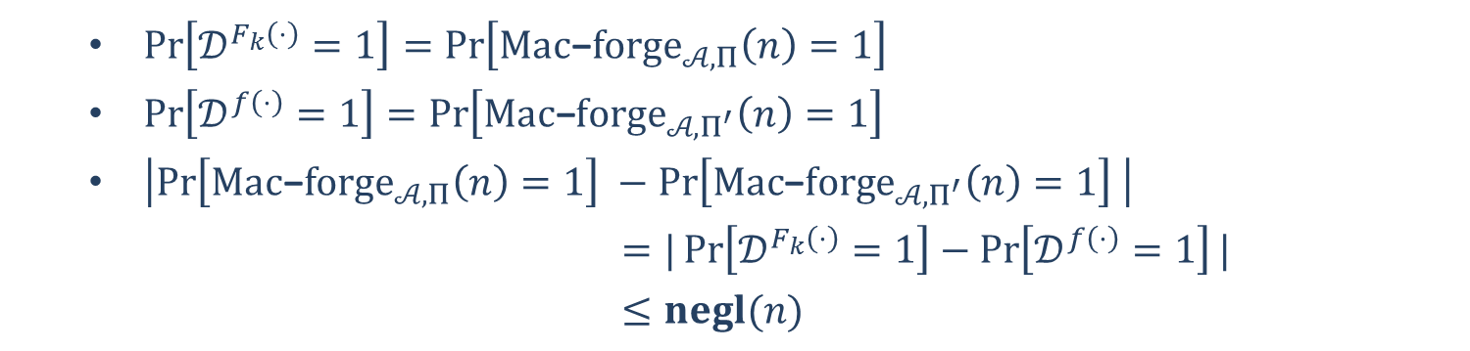



Security
Part 1: $\left|\operatorname{Pr}\left[Mac\text{−}forge_{𝒜,Π}\left(n\right)=1\right] −\operatorname{Pr}\left[Mac\text{−}forge_{𝒜,Π^{′}}\left(n\right)=1\right] \right|≤negl(n)$
$$𝒪$$
$$𝒟$$
$$𝒜$$
$$m_{i}$$
$$m_{i}, i∈[q]$$
$$t_{i}=𝒪(m_{i})$$
$$t_{i}$$
$$m$$
$$(m,t)$$
$$t′=𝒪(m)$$
$$output 1 iff$$
$m∉\left\{m_{i}\right\}$
$t^{′}=t$
$\operatorname{Pr}\left[𝒟^{F_{k}\left(⋅\right)}=1\right]=\operatorname{Pr}\left[Mac\text{−}forge_{𝒜,Π}\left(n\right)=1\right]$
$\operatorname{Pr}\left[𝒟^{f\left(⋅\right)}=1\right]=\operatorname{Pr}\left[Mac\text{−}forge_{𝒜,Π^{′}}\left(n\right)=1\right]$
$\left|\operatorname{Pr}\left[Mac\text{−}forge_{𝒜,Π}\left(n\right)=1\right] −\operatorname{Pr}\left[Mac\text{−}forge_{𝒜,Π^{′}}\left(n\right)=1\right] \right|$
$=|\operatorname{Pr}\left[𝒟^{F_{k}\left(⋅\right)}=1\right]−\operatorname{Pr}\left[𝒟^{f\left(⋅\right)}=1\right]|$
$≤negl(n)$

Slide 16



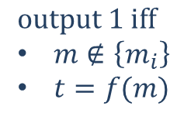

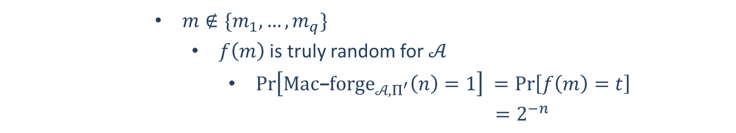

Security
Part 2: $\operatorname{Pr}\left[Mac\text{−}forge_{𝒜,Π^{′}}\left(n\right)=1\right] ≤negl(n)$
$$f←Func_{n}$$
$$m_{i}, i∈[q]$$
$$t_{i}=f\left(m_{i}\right)$$
$$(m,t)$$
$$output 1 iff$$
$m∉\left\{m_{i}\right\}$
$t=f(m)$
Challenger
$$𝒜$$
$m∉\{m_{1},…,m_{q}\}$
$f\left(m\right)$ is truly random for $𝒜$
$\operatorname{Pr}\left[Mac\text{−}forge_{𝒜,Π^{′}}\left(n\right)=1\right] =\operatorname{Pr}\left[f\left(m\right)=t\right]$
$=2^{−n}$

Slide 18
Arbitrary-Length MAC
QUESTION: How to construct an MAC for arbitrarily long messages?
Fixed-Length MAC: $Π=(Gen, Mac,Vrfy)$, based on PRF
$k∈{\left\{0,1\right\}}^{n}, ∀m∈{\left\{0,1\right\}}^{n}, Mac\left(k,m\right)=F_{k}(m)$
EUF-CMA secure
Idea: Build an arbitrary-length MAC $Π^{′}=(Gen′, Mac′,Vrfy′)$ using $Π$?
Idea 1: $m=m_{1}⋯m_{d};t_{i}=Mac\left(k,m_{i}\right), t=t_{1}⋯t_{d}$
Block re-Ordering Attack: forgery $(m_{3}m_{2}m_{1}, t_{3}t_{2}t_{1})$
Idea 2: $m=m_{1}⋯m_{d};t_{i}=Mac\left(k,{i||m}_{i}\right), t=t_{1}⋯t_{d}$
Truncation attack: forgery $\left(m_{1}m_{2},t_{1}t_{2}\right), m_{d}$ is missed!
Idea 3: $m=m_{1}⋯m_{d};t_{i}=Mac\left(k,{l||i||m}_{i}\right), t=t_{1}⋯t_{d}$
Mix-and-match attack:
$\left(m_{1}m_{2}m_{3},t_{1}t_{2}t_{3}\right); \left(m_{1}^{′}m_{2}^{′}m_{3}^{′}, t_{1}^{′}t_{2}^{′}t_{3}^{′}\right)$
forgery $(m_{1}m_{2}m_{3}^{′}, t_{1}t_{2}t_{3}^{′})$

